Slide 1
MOTIVATION

Slide 2
SOME BASIC ASSUMPTIONS
Is that an organization has the right to influence the behavior of its employees?
Psychological contract
Freedom of choice
No internal or external constraints on behavior
Behaviour is amenable to change

Slide 3
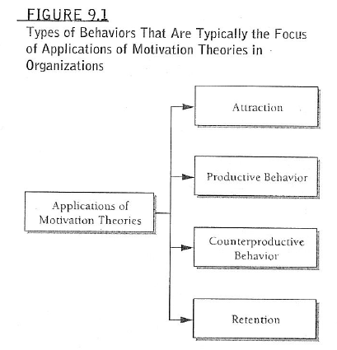
Behaviors organizations attempt to influence

Slide 4
Organizational reward systems
Tangible rewards
Pay
Merit pay
Incentive pay
Bonus
Employee stock ownership plans EOSPs
Profit sharing
Gain sharing
Non-cash payment
Fringe benefits
Perquisites
Intangible rewards
Recognition and awards
Praise
Status symbols
Increased autonomy and freedom

Slide 5
Tangible Rewards
Employee’s value to the organization
Indirect barometer of career success
money linked to employee performance and retention

Slide 6
A) PAY
Merit Pay
% ↑in annual pay based on outcome of performance
2) Incentive Pay - concretely tie to performance
3) Bonuses - amount of money is more meaningful
- linked to financial state of organization

Slide 7
4) Employee stock ownership plans EOSPs
Often with executive compensation
Wal-Mart, UPS’ employees may purchase ownership stake/stock
» pros
Excellent way to attract talented employees
Time _{value of stock} ↑ leads Retention ↑
Responsibility of employees ↑
Raise capital and avoid hostile takeovers/ investors
Low connection is seen between their individual performance and organization performance

Slide 8
5) Profit sharing
» pros
Competition ↓
Cooperation among employees ↑
Attract and retain high- quality employees
Enhance productivity and employee attitudes
Unlikely to be a powerful motivator
6) Gain sharing
Gain sharing difference from profit sharing
Based on cost savings rather than on profits
Cost reduction requires efforts of all individuals

Slide 9
B) Non-cash payment
7) Fringe benefits
health, dental, life insurance, pension benefits
Has impact on attraction and retention of employee
8) Perquisites (perks)
high-level executive perks

Slide 10
Intangible rewards
No financial or material gain
In many times, highly valued by employee
Recognition and awards
Praise
Timing
Sincerity of supervisory praise
Level of performance
Status symbols
Increased autonomy and freedom

Slide 11
EXECUTIVE COMPENSATION
Amount of compensation
Based on performance of organization
Very high executive salaries
Their skills are rare
Their decisions have enormous financial impact
Determined by negotiation with board members aided by consultant
Amount of executive compensation ↔ performance of organization
Compensation motivate executive
Social cycle

Slide 12
Motivation through the design of work
Design employee's job . higher employee involvement
Departmental structure . motivation
Whole organization

